Slide 1

Diameter and jDiameter
Dima Ionut Daniel

Slide 2
Contents
What is Diameter?
Diameter History
Diameter Features
Diameter Architecture
Diameter Message Format
Diameter Offline Charging
Diameter Online Charging
Diameter Transport Concepts
What is jDiameter?
Mobicents Diameter Stack
Mobicents Diameter Core
Diameter Dictionary
Multiplexor (MUX)
Conclussion
Bibliography

Slide 3

What is Diameter?
Diameter is an authentication, authorization, and accounting protocol for computer networks.
Diameter base protocol is defined in RFC 6733 (Obsoletes: RFC 3588).
Each application is defined by an application identifier and can add new command codes and/or new mandatory AVPs.
Adding a new optional AVP does not require a new application.

Slide 4
What is Diameter? (cont.)
Examples of Diameter applications.
Diameter Mobile IPv4 Application (MobileIP, RFC 4004)
Diameter Network Access Server Application (NASREQ, RFC 4005)
Diameter Extensible Authentication Protocol Application (RFC 4072)
Diameter Credit-Control Application (DCCA, RFC 4006)
Diameter Session Initiation Protocol Application (RFC 4740)
Various applications in the 3GPP IP Multimedia Subsystem
HSS and the SLF communicate using the Diameter protocol.

Slide 5
Diameter History
The Diameter protocol was initially developed by Pat R. Calhoun, Glen Zorn, and Ping Pan in 1998.
It’s purpose was to provide a framework for authentication, authorization and accounting (AAA) that could overcome the limitations of RADIUS.
RADIUS had issues with reliability, scalability, security and flexibility
RADIUS cannot deal effectively with remote access, IP mobility and policy control.
Like RADIUS, Diameter provides AAA functionality, but it is using TCP and SCTP instead of UDP.
The Diameter protocol is enhanced further by the development of the 3rd Generation Partnership Project (3GPP) IP Multimedia Subsystem (IMS).

Slide 6
Diameter Features
Reliable transport protocols (TCP or SCTP, not UDP).
Network or transport layer security (IPsec or TLS).
Larger address space for attribute-value pairs (AVPs) and identifiers (32 bits instead of 8 bits).
Both stateful and stateless models can be used.
Capability negotiation.
Supports application layer acknowledgements, defines failover methods and state machines (RFC 3539).
Error notification.
Better roaming support.
More easily extended; new commands and attributes can be defined.
Basic support for user-sessions and accounting.

Slide 7
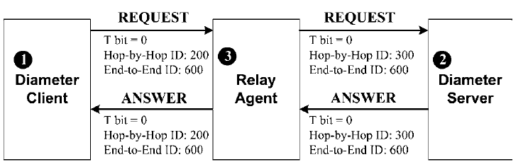
Diameter Architecture
Diameter follows the client–server architecture where a client and a server interact through the Diameter request and answer message exchange.
A Diameter relay agent may be used to forward a Diameter message to the appropriate destination.

Slide 8
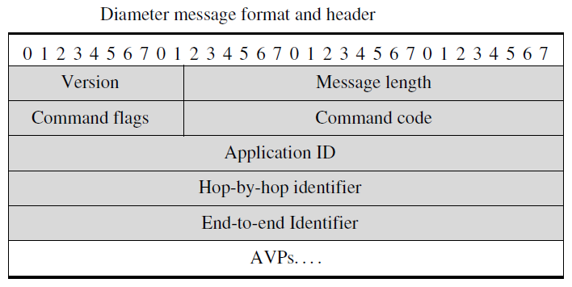
Diameter Message Format
A diameter message consists of a 20-octet header followed by several Attribute-Value Pairs (AVPs).
The Diameter header fields are described as follows:
Version field is set to "1".
Message Length field indicates the length of the Diameter message.
Command Flags field indicates 8 bits, 1-4 bits are reserved.
the "R" bit indicates that the message is a request(1) or an answer(0).
the "P" bit indicates that the message is proxied (1) or locally processed(0).
the "E" bit is always set to value 0. In an answer that bit can indicate error(1) or no error(0).
the "T" bit indicates that the message is the original message(0), or a retransmitted message(1).

Slide 9
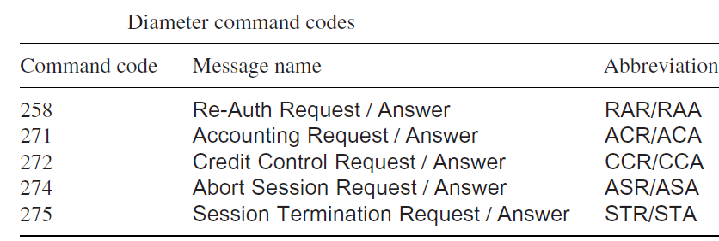
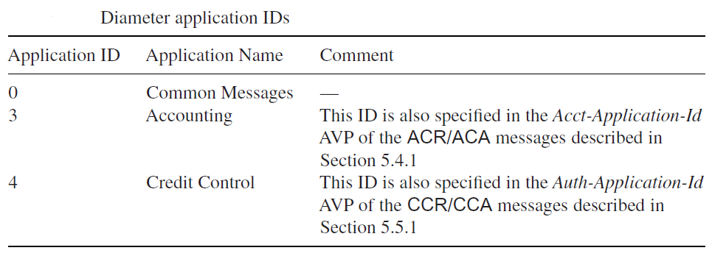
Diameter Message Format(cont.)
The Command Code field identifies the message type. Each request/answer message pair is assigned a unique command code.
The Application-ID field identifies the target application of the message.
The Hop-by-Hop Identifier is used to match a Diameter answer message with the
corresponding request message.
The End-to-End Identifier is a sequence number used to detect a duplicate Diameter
message.

Slide 10
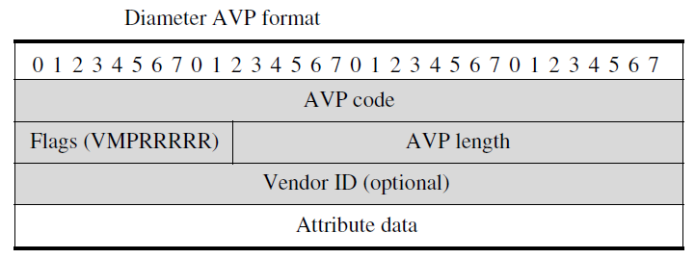
Diameter Message Format(cont.)
The AVP code identifies the type of information (attribute) included in the attribute data field of the AVP.
AVP code values are standardized by IETF.
Flags
the "M" bit within the flag fields of the AVP is called the Diameter “mandatory” bit.
the "P" bit indicates the need for encryption for end-to-end security.
the RRRRR bits indicate existence of 5 reserved bits in the flags field.

Slide 11
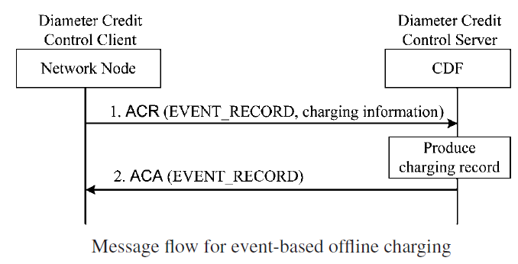
Diameter Offline Charging
Offline charging for both events and sessions are performed between an IMS node and the CDF through the Rf reference point.
IMS offline charging is achieved by using the Diameter Accounting Request (ACR) and Accounting Answer (ACA) messages.
In order to exchange charging information, the ACR message is sent from a Diameter client to a Diameter server through the Rf interface.
The Diameter server then sends the ACA message to acknowledge an ACR message.

Slide 12
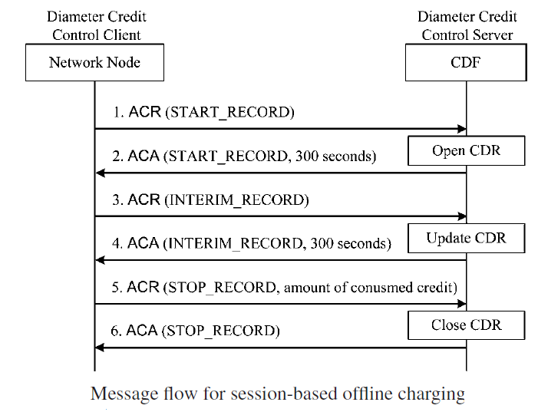
Diameter Offline Charging (cont.)
Session-based offline charging is described below

Slide 13
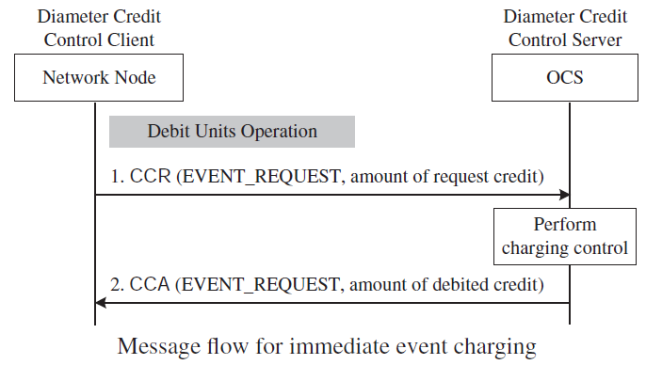
Diameter Online Charging
Diameter Credit Control (DCC) application communicates with the OCS through the Ro interface.
The GGSN uses the Credit Control Request (CCR) message to transfer the GPRS charging information to the OCS.
The OCS uses the Credit Control Answer (CCA) message to reserve credit units (or quotas) for the GPRS session.
There are two basic operations in the charging control:
Unit determination refers to the calculation of the number of non-monetary units
Rating refers to the calculation of a price out of the non-monetary units

Slide 14
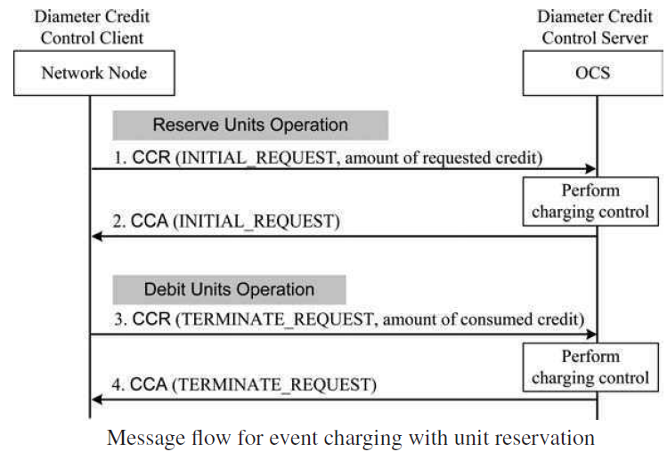
Diameter Online Charging (cont.)
Unit determination and rating are performed at the OCS.
CCR message with CC-Request-Type "INITIAL_REQUEST" send the OCS indicates the amount of requested credit.
CCR message with CC-Request-Type "TERMINATION_REQUEST" send the OCS indicates the consumed credit.

Slide 15
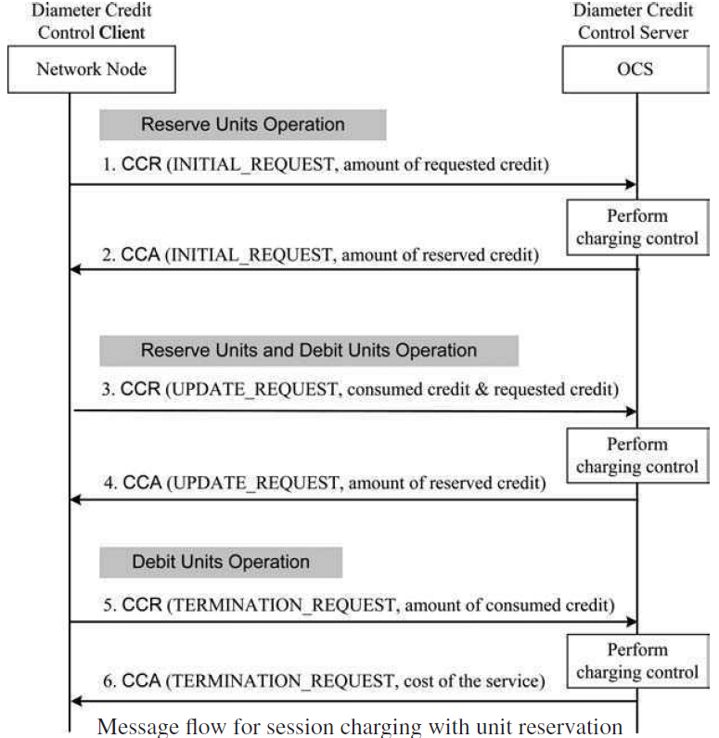
Diameter Online Charging (cont.)
During the service session, the granted credit units may be depleted.
If so, the network node sends a CCR message with CC-Request-Type "UPDATE_REQUEST" to the OCS.

Slide 16
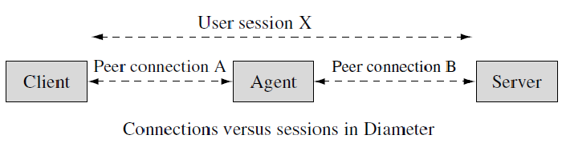
Diameter Transport Concepts
Diameter clients supports either TCP or SCTP.
Diameter specifications define two important transport concepts, namely “session” and “connection”.
Session is a logical concept at the application layer and is established end to end between a device and a server. A session is processed by end parties (device or server) and therefore is identified by a session ID AVP.
Connection is, on the other hand, a transport level concept and is established between any two peers that send and receive Diameter messages.

Slide 17
What is jDiameter?
Mobicents Diameter provides an Open Source Java implementation of the Diameter standard for Authentication, Authorization, and Accounting (AAA).
The Diameter Stack is the core component of the presented Diameter solution.
The Diameter Stack currently supports the following application sessions:
Base
Credit Control Application (CCA)
Sh
Ro
Rf
Cx/Dx
Gx
Gq'
Rx

Slide 18
Mobicents Diameter Stack
Diameter Stack has been designed to be extensible.
Diameter Stack performs the following tasks:
Manages connections to remote peers.
Manages session objects.
Routes messages on behalf of sessions.
Receives and delivers messages to assigned listeners (usually a session object).
Sessions use the stack and the services it provides to communicate with remote peers.
The application is the only place that holds references to sessions.

Slide 19
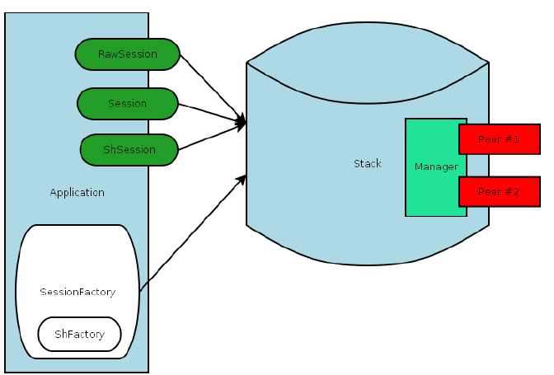
Mobicents Diameter Stack(cont.)
Application session factories perform two tasks:
server stack as factory for sessions.
server session objects as holders for session related resources, like state change listener, event listeners and context.

Slide 20
Mobicents Diameter Stack(cont.)
Mobicents Diameter Stack has the following software dependencies:
Pico Container
slf4j
Clustered setup also requires following:
JDiameter HA
JBoss Cache

Slide 21
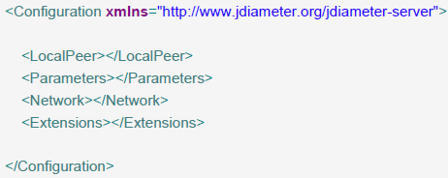
Mobicents Diameter Core
The stack is initially configured by parsing an XML file.
The <LocalPeer> element contains parameters that affect the local Diameter peer.
The <Parameters> element contains elements that specify parameters for the Diameter stack.
The <Network> element contains elements that specify parameters for external peers.

Slide 22
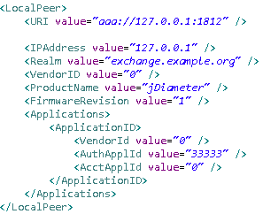
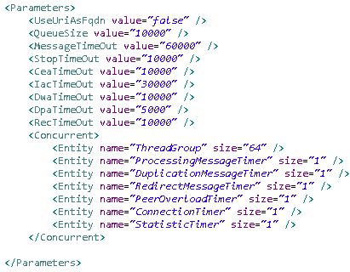
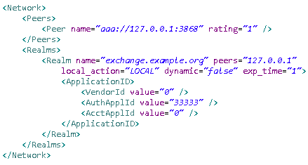
Mobicents Diameter Core(cont.)
Diameter client XML sample configuration

Slide 23
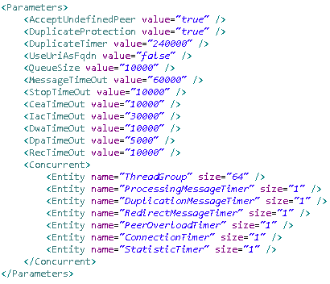
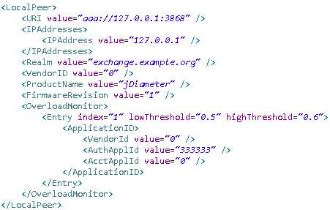
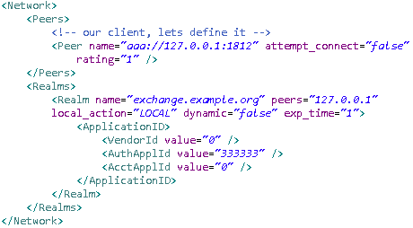
Mobicents Diameter Core(cont.)
Diameter server XML sample configuration

Slide 24
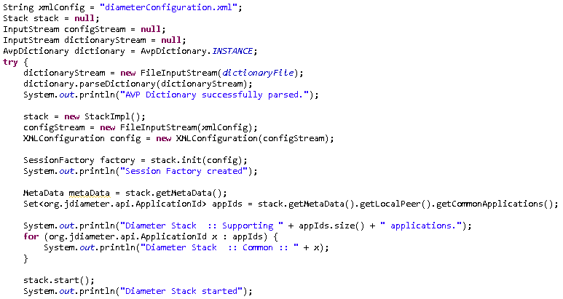
Mobicents Diameter Core(cont.)
Diameter stack is built with the following basic components:
Session Factory: creation of sessions - raw and specific application sessions.
Stack: used to establish connection and communicate with remote peers.

Slide 25
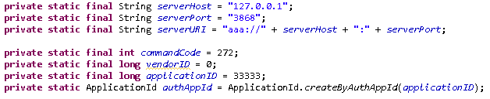
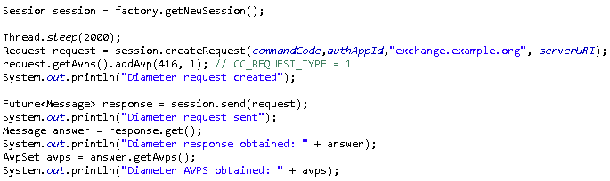
Mobicents Diameter Core(cont.)
RawSessions, Sessions and ApplicationSessions provide the means for dispatching and receiving messages.
The RawSession and the Session life span is controlled entirely by the application.
The ApplicationSession life time depends on the implemented state machine.

Slide 26
Diameter Dictionary
Validator is one of the Stack features.
The primary purpose of the Validator is to detect malformed messages, such as an Answer message containing a Destination-Host Attribute Value Pair (AVP).
The Validator is configured with a single XML file.
This file contains the structure definition for both messages and AVPs.
Upon creation of the Diameter Stack, the validator is initialized.
It performs the initialization by looking up the dictionary.xml file in classpath.

Slide 27
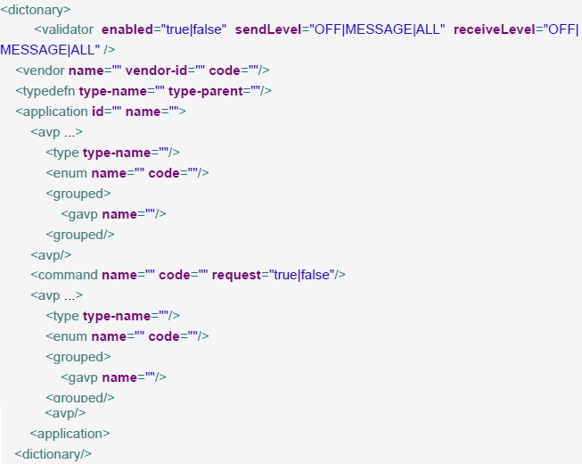
Diameter Dictionary(cont.)
The diameter dictionary contains AVP type, application ids, vendors ids, AVP, messages, enum, etc.

Slide 28
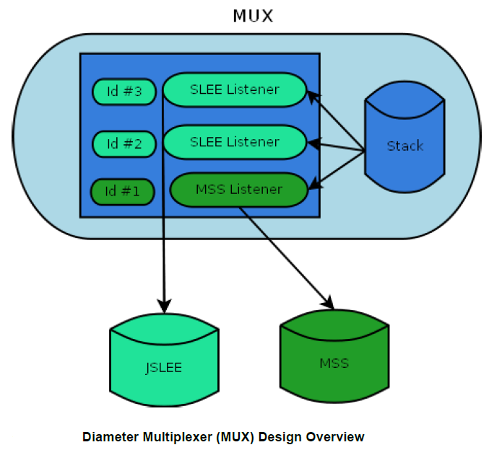
Multiplexor (MUX)
The Multiplexer (MUX) is designed as a stack wrapper and has 2 purposes:
It exposes the stack and allows it to be shared between multiple listeners.
Exposes the management operations for JMX clients, one of them being the RHQ Console.

Slide 29
Conclussion
jDiameter is an open source library that is used in the Mobicents JAIN SLEE diameter container.
jDiameter is very extensible due to external XML configuration.
jDiameter can be used as both client and server.

Slide 30

Bibliography
http://en.wikipedia.org/wiki/Diameter_(protocol)
Wiley - AAA and Network Security for Mobile Access Radius Diameter EAP PKI and IP Mobility
Charging for Mobile All-IP Telecommunications

Slide 31
Questions ?

